Slide 1
Addressing Modes

Slide 2
Special Roles of Registers
BX can be used as Address register
CX is used as default down counter register
DX is used to hold
16-bit I/O port address in variable port addressing
MS 16 bits of 32 bit result after multiplication
MS 16 bits of 32 bit numerator before division
Accumulator : 8-bit AL, 16-bit AX, 32-bit DX AX

Slide 3
Addressing Modes– The term addressing modes refers to the way in which the operand of an instruction is specified. The addressing mode specifies a rule for interpreting or modifying the address field of the instruction before the operand is actually executed.
Addressing modes for 8086 instructions are divided into two categories:
1) Addressing modes for data
2) Addressing modes for branch
The 8086 memory addressing modes provide flexible access to memory, allowing you to easily access variables, arrays, records, pointers, and other complex data types. The key to good assembly language programming is the proper use of memory addressing modes.

Slide 4
IMPORTANT TERMS
Starting address of memory segment.
Effective address or Offset: An offset is determined by adding any combination of three address elements: displacement, base and index.
Displacement: It is an 8 bit or 16 bit immediate value given in the instruction.
Base: Contents of base register, BX or BP.
Index: Content of index register SI or DI.
According to different ways of specifying an operand by 8086 microprocessor, different addressing modes are used by 8086.

Slide 5
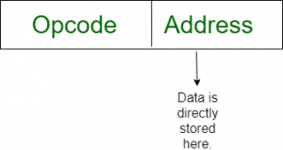
Immediate addressing mode (symbol #):
In this mode data is present in address field of instruction .Designed like one address instruction format. Note: Limitation in the immediate mode is that the range of constants are restricted by size of address field.
Example: MOV AL, 35H (move the data 35H into AL register)

Slide 6

Register mode: In register addressing the operand is placed in one of 8 bit or 16 bit general purpose registers. The data is in the register that is specified by the instruction. Here one register reference is required to access the data.
Example: MOV AX,CX (move the contents of CX register to AX register)

Slide 7
It means that the register is the source of an operand for an instruction. |  | Before |  | After
Ex.1: MOV CX, SI | CX | 1234H |  | 5678H
 | SI | 5678H |  | 5678H
 |  | Before |  | After
Ex.2: MOV DL, AH | DL | 89H |  | BCH
 | AH | BCH |  | BCH

Slide 8
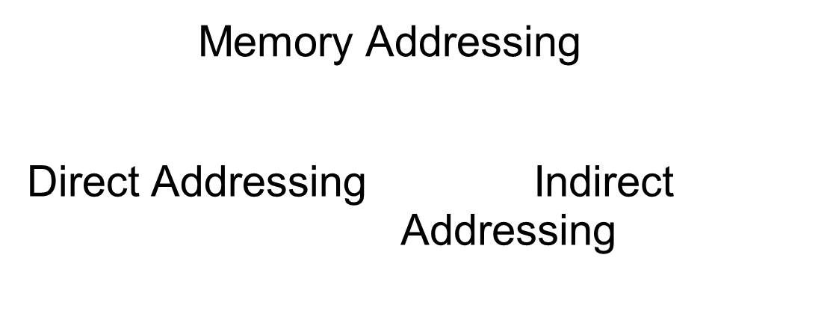
Memory addressing modes

Slide 9

Direct addressing/ Absolute addressing Mode (symbol [ ]):
The operand’s offset is given in the instruction as an 8 bit or 16 bit displacement element. In this addressing mode the 16 bit effective address of the data is the part of the instruction. Here only one memory reference operation is required to access the data.
Example: ADD AL,[0301] //add the contents of offset address 0301 to AL

Slide 10
 |  |  | Before |  | After
Ex.1: MOV BX, DS:5634H | BX | ABCDH |  |  | 8645H
 | DS:5634H | 45H |  |  | LS byte
 | DS:5635H | 86H |  |  | MS byte

Slide 11
 |  | Before |  | After
Ex.2: MOV CL, DS:5634H | CL | F2H |  | 45H
 | DS:5634H | 45H
 | DS:5635H | 86H

Slide 12
Indirect addressing Mode
In this mode address field of instruction contains the address of effective address. Here two references are required. 1st reference to get effective address. 2nd reference to access the data. Based on the availability of Effective address,
Indirect mode is of two kind:
Register Indirect: In this mode effective address is in the register, and corresponding register name will be maintained in the address field of an instruction. Here one register reference, one memory reference is required to access the data.
Memory Indirect: In this mode effective address is in the memory, and corresponding memory address will be maintained in the address field of an instruction. Here two memory reference is required to access the data.

Slide 13
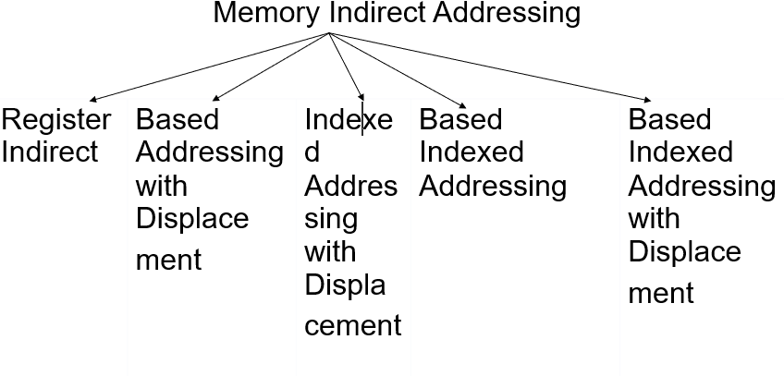
Memory Indirect addressing

Slide 14
Memory Indirect addressing
This addressing mode allows data to be addressed at any memory location through an offset address held in any of the following registers: BP, BX, DI & SI.

Slide 15
Register Indirect Addressing
This addressing mode allows data to be addressed at any memory location through an offset address held in any of the following registers: BP, BX, DI & SI.
Example: MOV AX, [BX] ; Suppose the register BX contains 4895H, then the contents of 4895H are moved to AX
ADD CX, {BX}
 |  | Before |  | After
Ex.1: MOV CL, [SI] | CL | 20H |  | 78H
 | SI | 3456H
 | DS:3456H | 78H

Slide 16
 |  | Before |  | After
Ex.2: MOV DX, [BX] | DX | F232H |  | 3567H
 | BX | A2B2H
 | DS:A2B2H | 67H |  | LS byte
 | DS:A2B3H | 35H |  | MS byte
Only SI, DI , and BX can be used inside [] from memory addressing point of view. From user point of view [BP] is also possible. Provides 3 ways of addressing a memory operand.

Slide 17
Based Addressing with displacement
In this addressing mode, the offset address of the operand is given by the sum of contents of the BX/BP registers and 8-bit/16-bit displacement.
 |  | Before |  | After
Ex.1: MOV DH, 2345H[BX] | DH | 45H |  | 67H
2345H is 16 bit displacement | BX | 4000H
4000H+2345H = 6345H | DS:6345H | 67H

Slide 18
 |  | Before |  | After
Ex.2: MOV AX, 45H[BP] | AX | 1000H |  | CDABH
45H is 8 bit displacement | BP | 3000H
3000H + 45H = 3045H | SS:3045H | ABH |  | LS byte
It is SS when BP is used | SS:3046H | CDH |  | MS byte

Slide 19
Base register can only be BX or BP
Base Addressing with displacement provides 4 ways of addressing an operand in memory

Slide 20
Indexed addressing with displacement
In this addressing mode, the offset address of the operand is given by the sum of contents of the SI/DI registers and 8-bit/16-bit displacement.
 |  | Before |  | After
Ex.1: MOV CL, 2345H[SI] | CL | 60H |  | 85H
2345H is 16 bit displacement | SI | 6000H
6000H+2345H = 8345H | DS:8345H | 85H

Slide 21
 |  | Before |  | After
Ex.2: MOV DX, 37H[DI] | DX | 7000H |  | B2A2H
37H is 8 bit displacement | DI | 5000H
5000H + 37H = 5037H | DS:5037H | A2H |  | LS byte
 | DS:5038H | B2H |  | MS byte
Index register can only be SI or DI
Indexed Addressing with displacement provides 4 ways of addressing an operand in memory

Slide 22
Based Indexed Addressing
In this addressing mode, the offset address of the operand is computed by summing the base register to the contents of an Index register.
 |  | Before |  | After
Ex1:MOV CL,[SI][BX] | CL | 40H |  | 67H
 | SI | 2000H
 | BX | 0300H
2000H+0300H=2300H | DS:2300H | 67H

Slide 23
 |  | Before |  | After
Ex2:MOV CX,[BP][DI] | CX | 6000H |  | 6385H
 | BP | 3000H
 | DI | 0020H
3000H+0020H=3020H | SS:3020H | 85H |  | LS byte
It is SS when BP is used | SS:3021H | 63H |  | MS byte
Based Index Addressing Provides 4 ways of addressing an operand in memory
One Register must be a Base register and the other must be an Index register
For ex. MOV CX, [BX][BP] is an invalid instruction

Slide 24
Based Indexed Addressing with Displacement
In this addressing mode, the operands offset is computed by adding the base register contents. An Index registers contents and 8 or 16-bit displacement
 |  | Before |  | After
Ex1: MOV DL, 37H[BX+DI] | DL | 40H |  | 12H
37H is 8-bit Displacement | BX | 2000H
 | DI | 0050H
2000H+0050H+37H=2087H Mov 37H[BX+DI],DL | DS:2087H | 12H

Slide 25
 |  | Before |  | After
Ex2: MOV BX,1234H[SI+BP] BX |  | 3000H |  | 3665H
1234 is 16bit Displacement | SI | 4000H
 | BP | 0020H
4000+0020+1234=5254H | SS:5254H | 65H |  | LS byte
It is SS when BP is used | SS:5255H | 36H |  | MS byte
Provides 8 ways of addressing an operand in memory

Slide 26
Memory modes as derivatives of Base Index addressing with disp.
Instruction | Base Reg. | Index Reg. | Disp | Addressing Mode
MOV BX, DS:5634H | No | No | Yes | Direct Addressing
MOV CL,[SI] | No | Yes | No | Register Indirect
MOV DX,[BX] | Yes | No | No
MOV DH, 2345H[BX] | Yes | No | Yes | Base addr. with Disp.
MOV DX, 35H[DI] | No | Yes | Yes | Index addr. with Disp.
MOV CL, [SI+BX] | Yes | Yes | No | Based Index Addr.
MOV DL, 37H[BX+DI] | Yes | Yes | Yes | Base Index Addr with disp

Slide 27
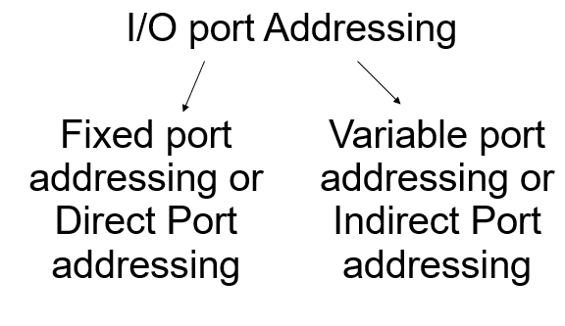
Input/Output port Addressing

Slide 28
Fixed port Addressing
 |  | Before |  |  | After
Ex.1: IN AL, 83H | AL | 34H |  |  | 78H
 | Input port no. 83H | 78H
 |  | Before |  | After
Ex.2: IN AX, 83H | AX | 5634H |  | F278H
 | Input port no. 83H | 78H
 | Input port no. 84H | F2H

Slide 29
 |  | Before |  | After
Ex.3: OUT 83H, AL | AL | 50H
Output port no. 83H |  | 65H |  | 50H
 |  | Before |  | After
Ex.4: OUT 83H, AX | AX | 6050H
Output port no. 83H |  | 65H |  | 50H
Output port no. 84H |  | 40H |  | 60H

Slide 30
Variable port Addressing
IN and OUT instructions are allowed to use only AL or AX registers
Port address in the range 00 to FFH is provided in the instruction directly
I/O port address provided in DX register only
Port addresses range from 0000H to FFFFH
Data transfer with AL or AX only

Slide 31
 |  | Before |  | After
Ex. 1: IN AL, DX | AL | 30H |  | 60H
 | DX | 1234H
 | Input port no. 1234H | 60H
 |  | Before |  | After
Ex. 2: IN AX, DX | AX | 3040H |  | 7060H
 | DX | 4000H
 | Input port no. 4000H | 60H
 | Input port no. 4001H | 70H

Slide 32
 |  | Before |  | After
Ex. 3: OUT DX, AL | AL | 65H
 | DX | 5000H
Output port no. 5000H |  | 80H |  | 65H
 |  |  | Before |  | After
Ex. 4: OUT DX, AX |  | AX | 4567H
 | DX |  | 5000H
Output port no. 5000H |  |  | 25H |  | 67H
Output port no. 5001H |  |  | 36H |  | 45H

